Slide 1
Franchise Growth Benchmark Survey 2023
Unveiling Average Consumer and FranDev CPL and CPA Across Franchise Verticals

Slide 2
Table of Contents
Survey Responses
Consumer Marketing
Franchise Development Marketing

Slide 3
SURVEY SAYS

Slide 4
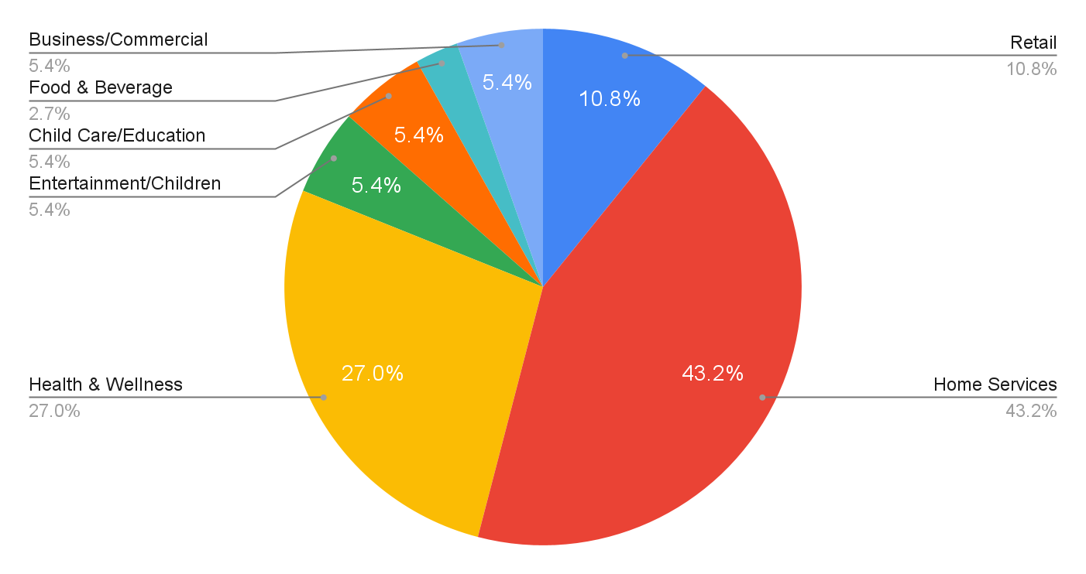
What Industry are you in?

Slide 5
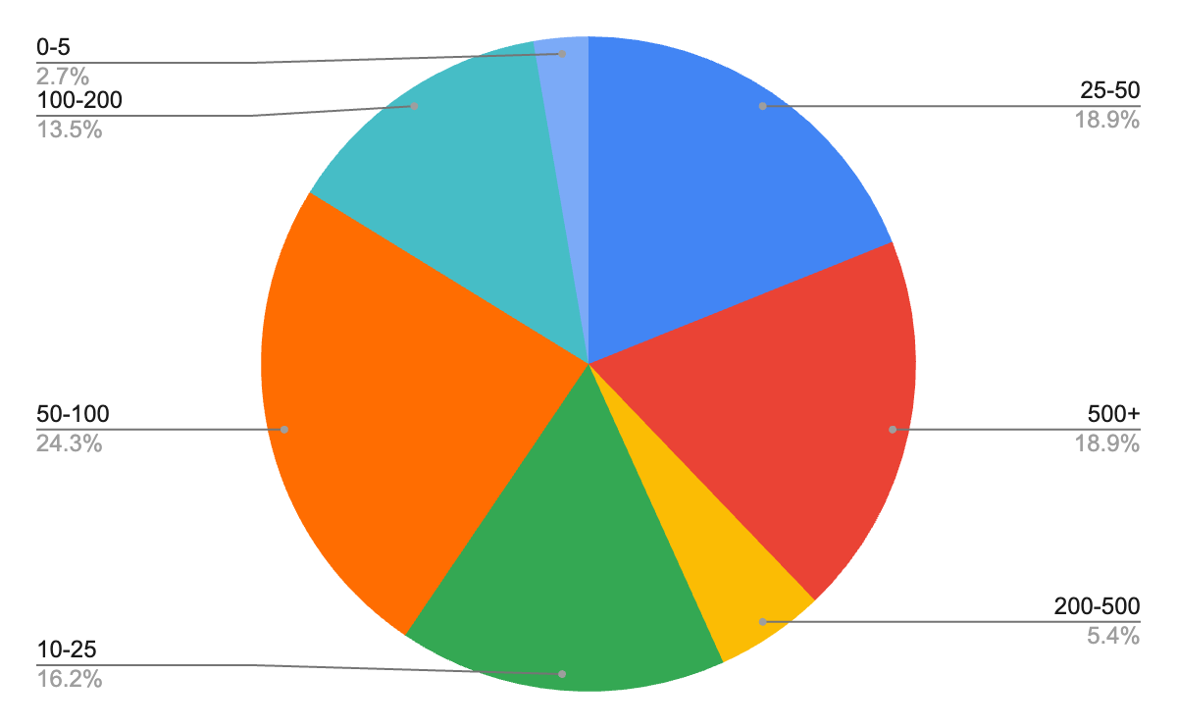
How Many Units do you Have Open?

Slide 6
Consumer Marketing

Slide 7
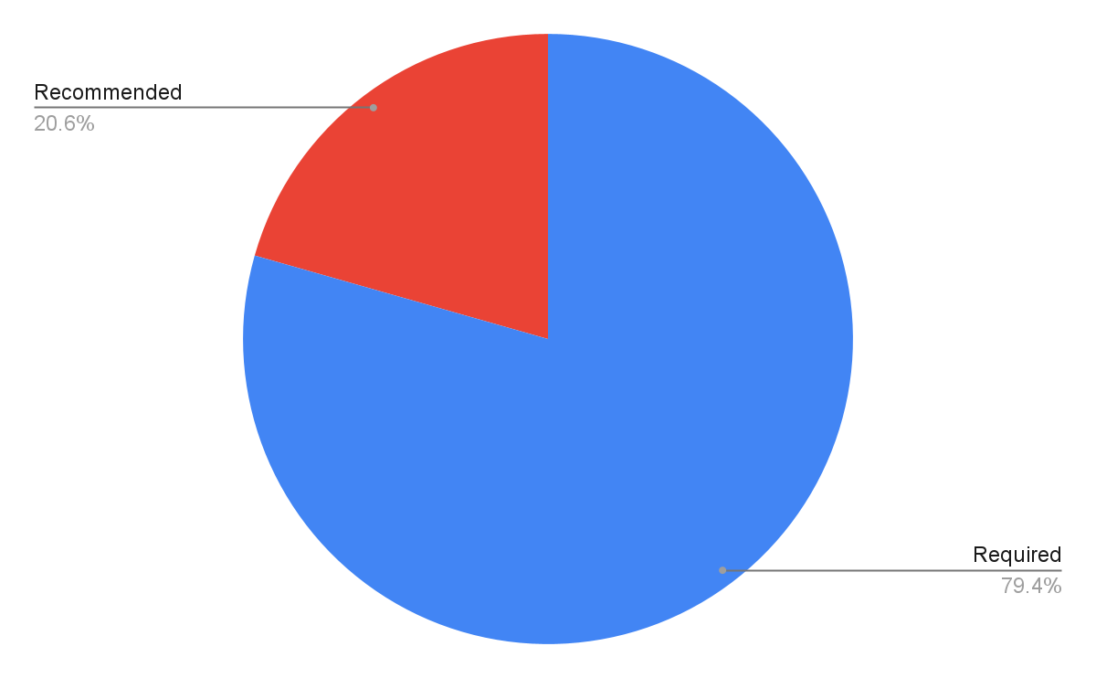
What is your monthly marketing spend structure?

Slide 8
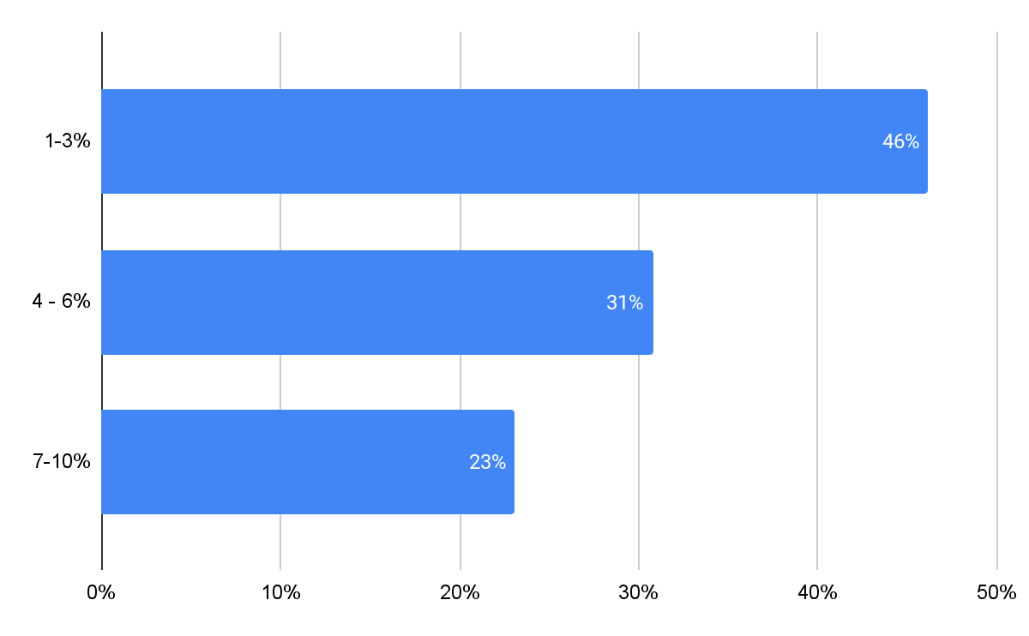
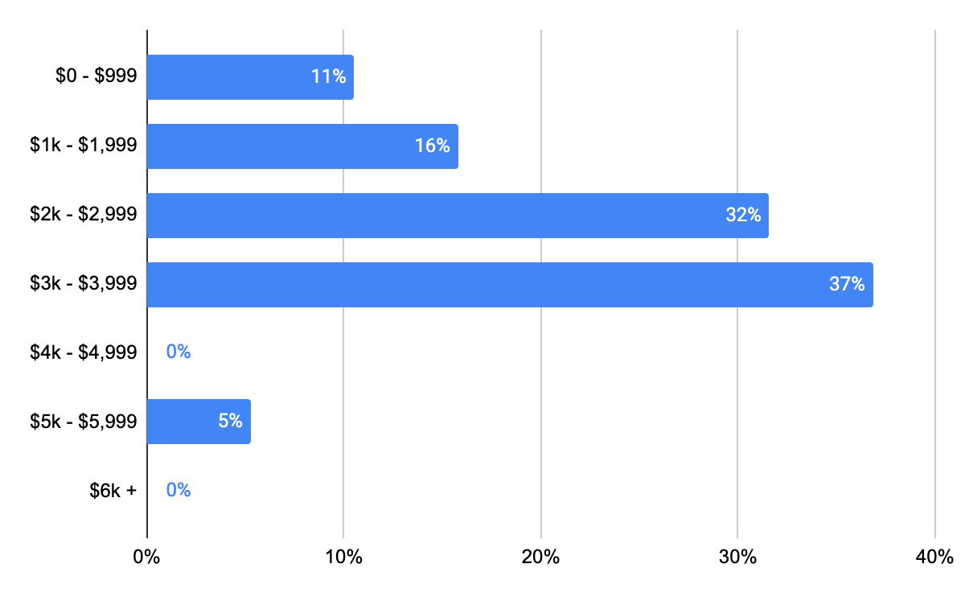
What is the required or recommended monthly marketing spend?
Percent Gross Revenue
Hard Dollars

Slide 9
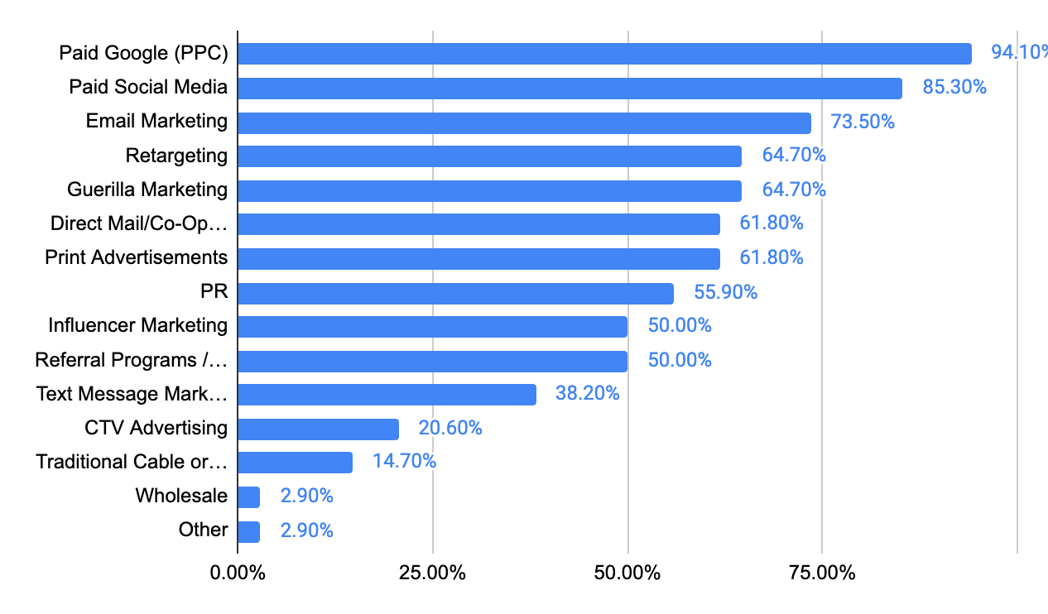
Marketing Channels that franchisees use to attract new customers

Slide 10
What is the annual value of a client / customer?
$2,500 average annual value of a customer
*All industries except F&B
Industry | Average Annual Value
Business / Commercial Services | $2,000
Child Care / Education | $900
Entertainment / Children Entertainment | $8,100
Food and Beverage
Health and Wellness | $1,942
Home Services | $1,895
Retail | $832

Slide 11
What is your average cost-per-lead (CPL)?
$110 average CPL
*Across all industries
Industry | Average CPL
Business / Commercial Services
Child Care / Education | $34
Entertainment / Children Entertainment | $25
Food and Beverage
Health and Wellness | $201
Home Services | $93
Retail | $55

Slide 12
What is your average cost-per-new-client (CPA)?
$110 average CPA
*Across all industries
Industry | Average CPA
Business / Commercial Services
Child Care / Education | $28
Entertainment / Children Entertainment
Food and Beverage
Health and Wellness | $72
Home Services | $430
Retail | $53

Slide 13
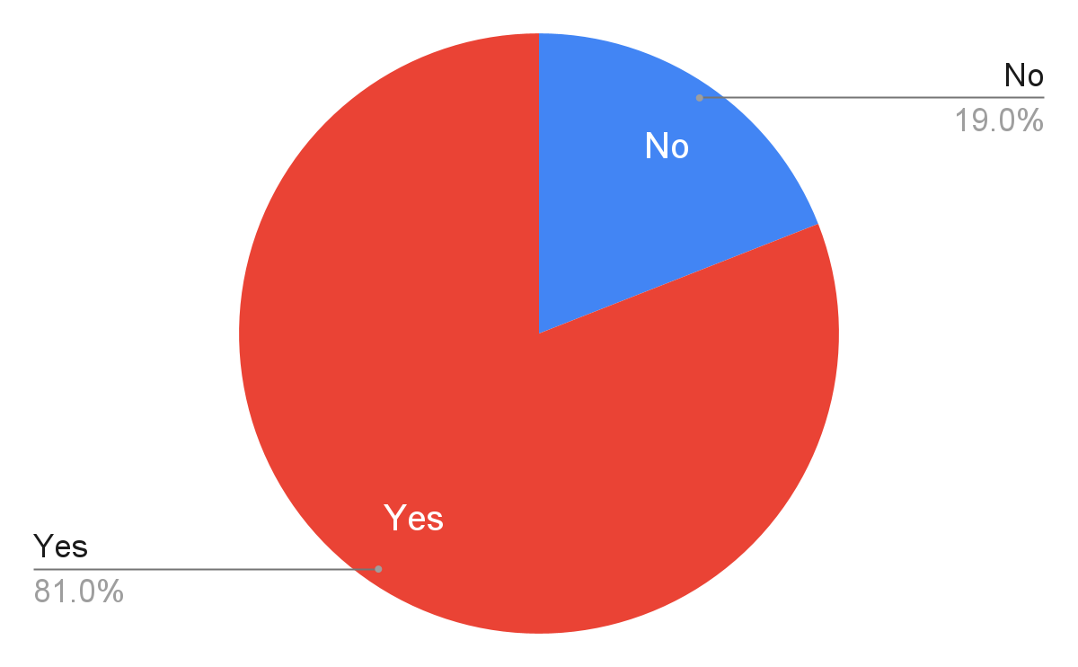
Have these numbers increased in the past 12 months?

Slide 14
Franchise Development Marketing

Slide 15
Required initial investment level including the franchise fee
$286k Average Initial Investment
*Across all industries
Industry | Average Fee
Business / Commercial Services | $183,500
Child Care / Education | $200,000
Entertainment / Children Entertainment | $200,000
Food and Beverage | $600,000
Health and Wellness | $428,333
Home Services | $172,246
Retail | $373,333

Slide 16
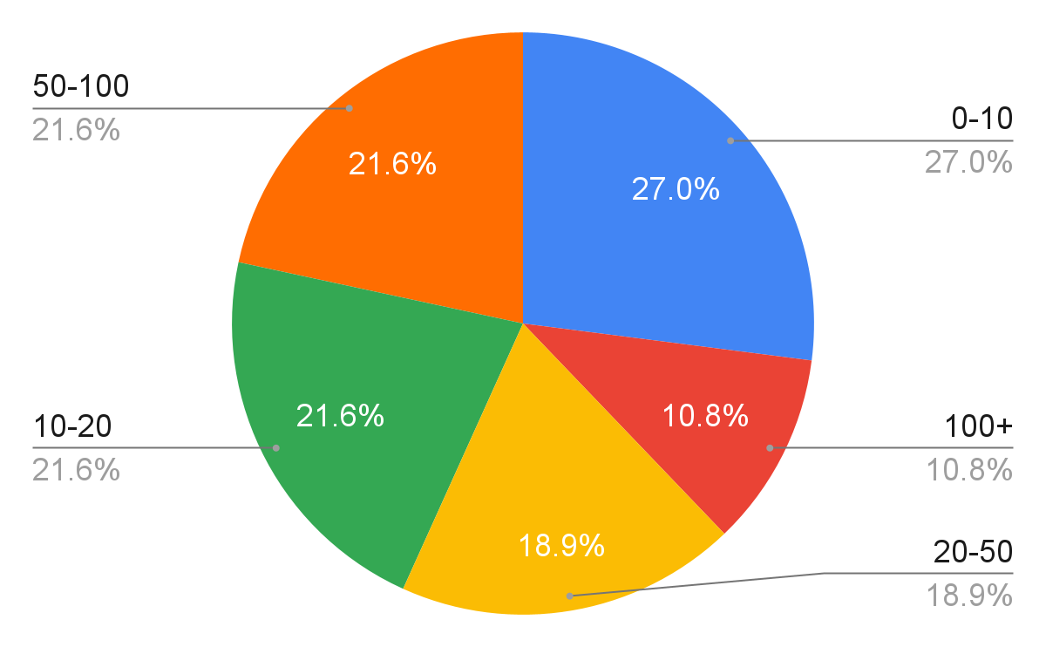
How many new locations are you looking to sign in the next 12 months?

Slide 17
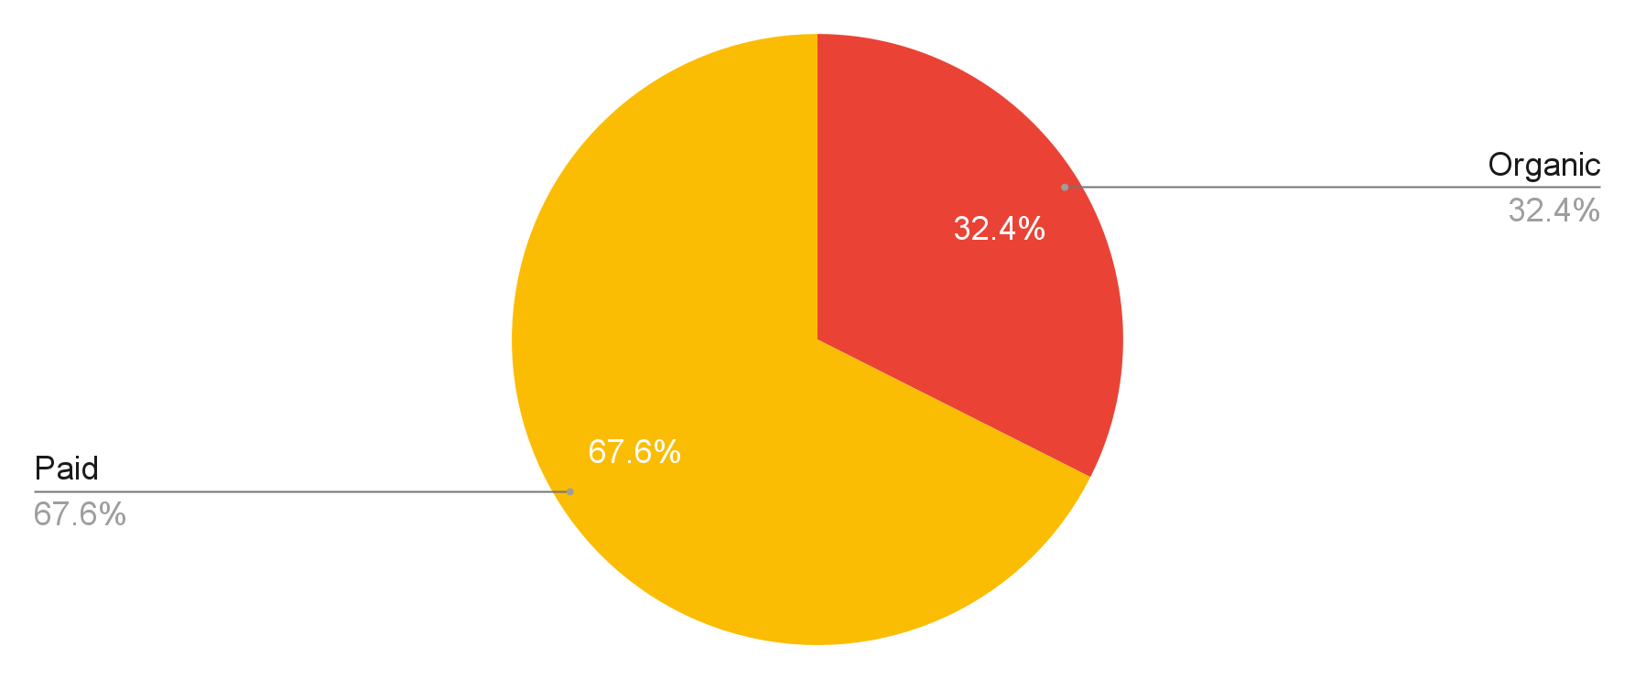
Do you get the majority of your leads organically or through paid methods?

Slide 18
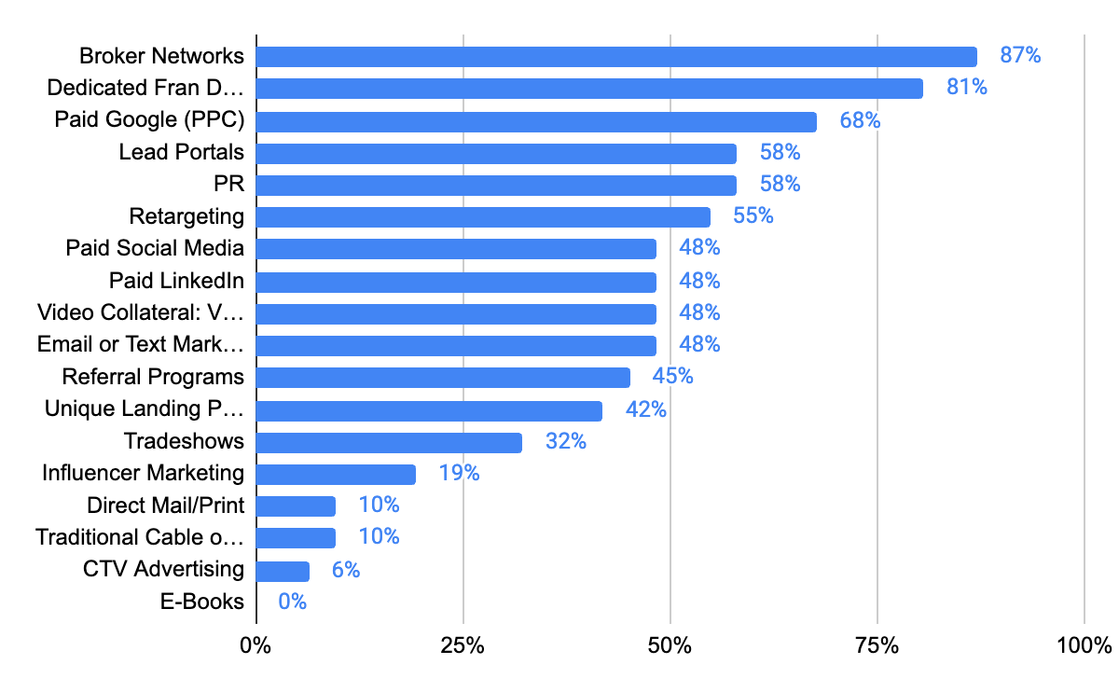
Marketing channels that you use to attract new franchisees

Slide 19
What is your annual franchise development budget?
$700k Average FranDev Budget
*Across all industries
Industry | Average Budget
Business / Commercial Services | $500,000
Child Care / Education | $60,000
Entertainment / Children Entertainment | $30,000
Food and Beverage | $200,000
Health and Wellness | $736,429
Home Services | $1,090,556
Retail | $333,333

Slide 20
What is your cost-per-lead?
$284 Average CPL
*Across all industries
Industry | Average CPL
Business / Commercial Services | $200
Child Care / Education | $120
Entertainment / Children Entertainment | $250
Food and Beverage
Health and Wellness | $339
Home Services | $207
Retail | $750

Slide 21
What is your cost-per-qualified-lead (CPQL)?
$1,029 Average CPQL
*Across all industries
Industry | Average CPQL
Business / Commercial Services | $1,000
Child Care / Education
Entertainment / Children Entertainment | $2,000
Food and Beverage
Health and Wellness | $588
Home Services | $1,029
Retail | $2,000

Slide 22
What is your cost-per-acquisition (CPA)?
$15,930 Average CPA
*Across all industries
Industry | Average CPA
Business / Commercial Services | $42,000
Child Care / Education | $10,000
Entertainment / Children Entertainment | $10,000
Food and Beverage
Health and Wellness | $13,213
Home Services | $15,646
Retail | $9,500

Slide 23
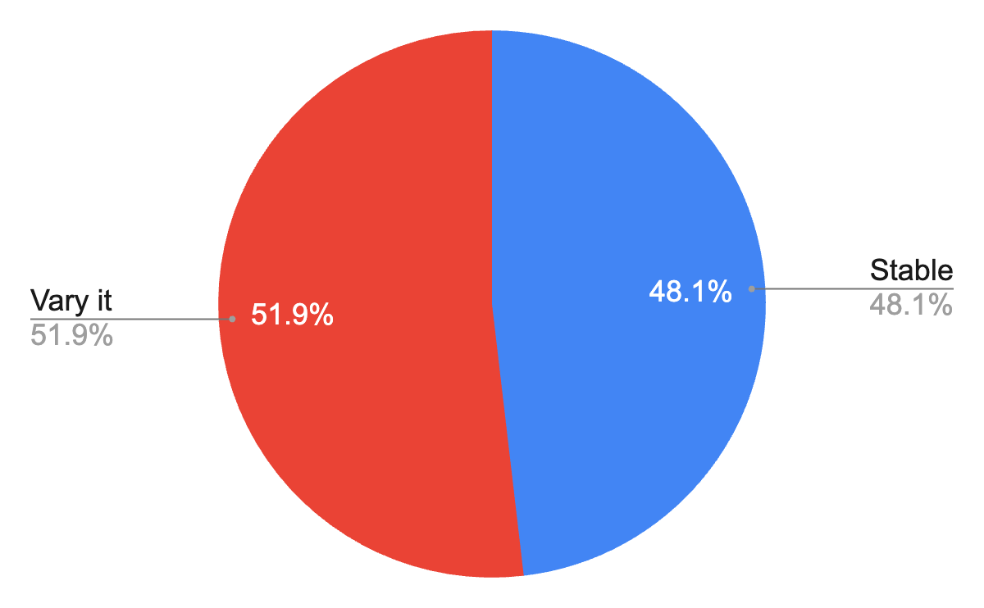
Do you vary your spending based on seasonality or lead trends or keep the same spend each month?
An even split across all industries, including home services

Slide 24
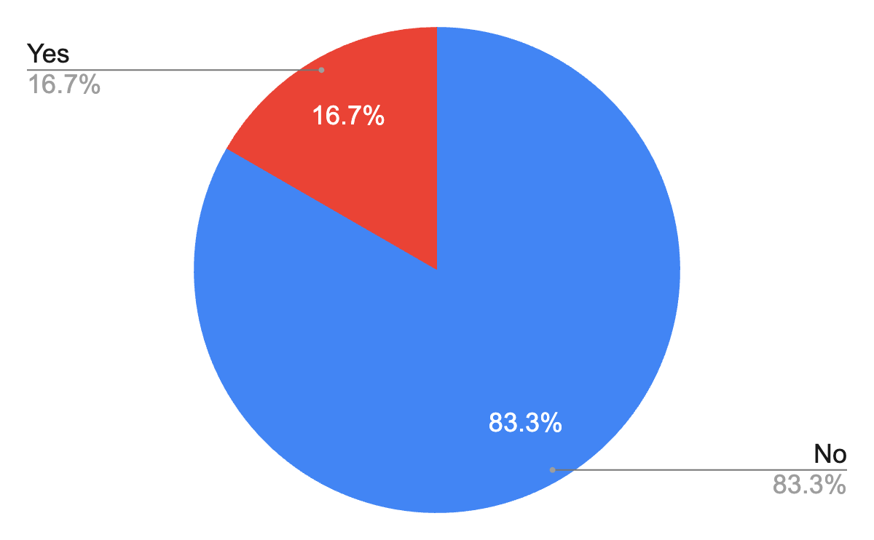
Do you use area developers?

Slide 25
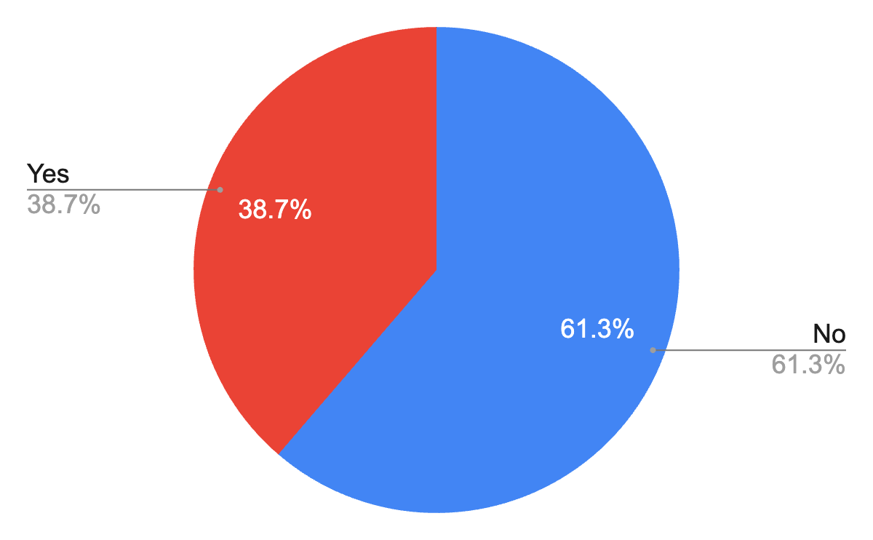
Do you have a dedicated marketing person for solely franchise development?

Slide 26
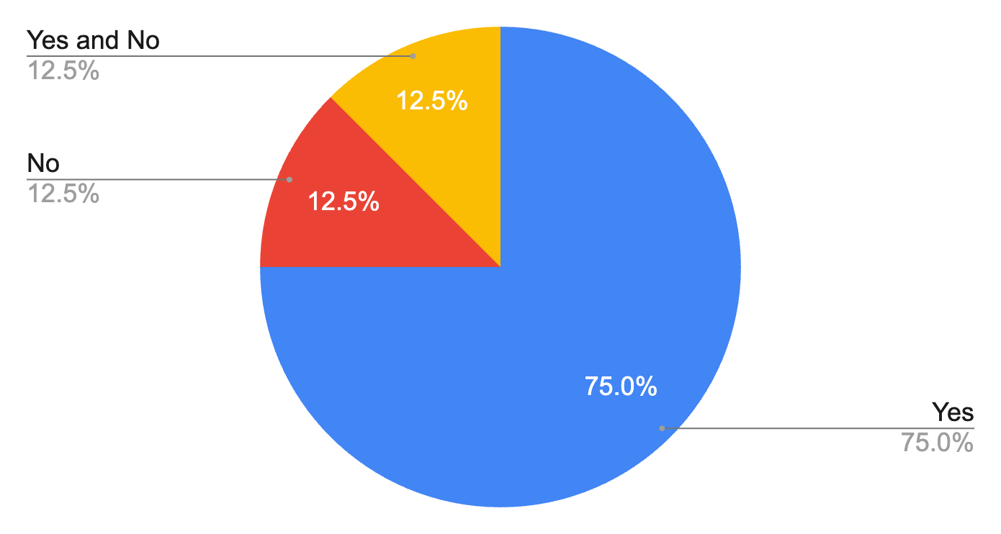
Does your brand validate well and often?

Slide 27
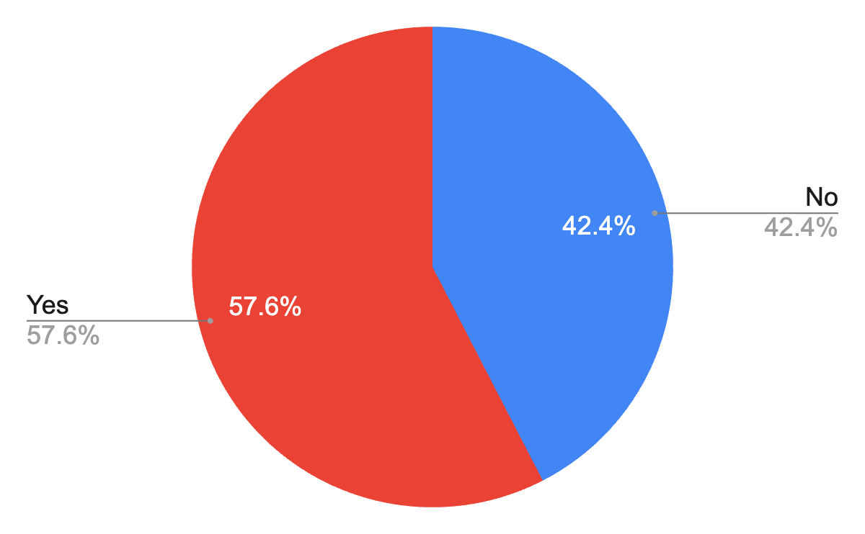
Do you use an annual outside survey to monitor franchisee satisfaction?

Slide 28
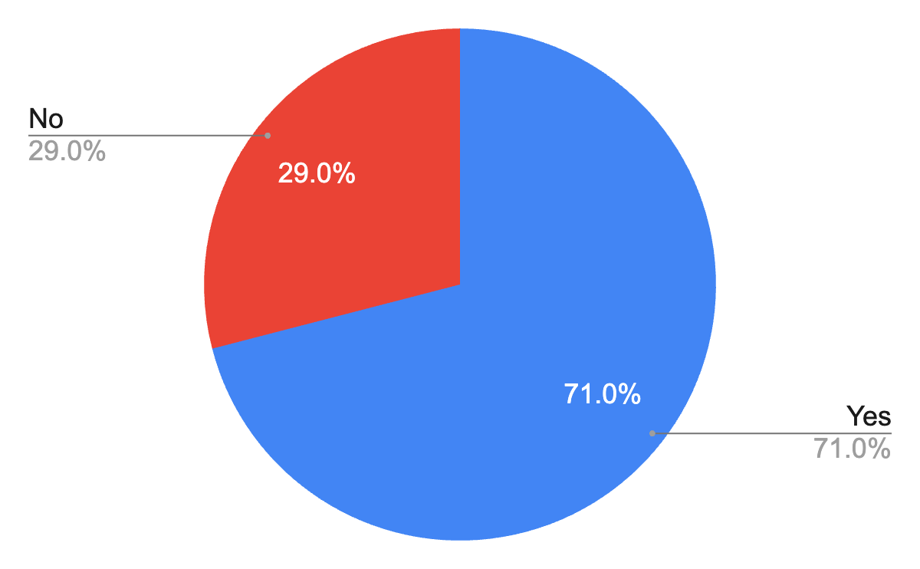
Have these costs increased in the past 12 months?

Slide 29
Want the Full Report?
Can’t have it.
Just kidding! We will be emailing the full report in a couple of weeks.

